Slide 1
2024 California Economic &
Housing Market Forecast
Bridge Association of REALTORS®
Jordan G. Levine
Senior Vice President & Chief Economist
California Association of REALTORS®
September 27, 2023

Slide 2
Internal & external forces accelerating change
Strengths
Market Not Crashing: Prices Rising
Economy Continues to Expand
Homeownership Desired & Valuable
Weaknesses
Affordability & Homeownership Shrinks
Population/Remote Work/Commercial
Rates Expected to Remain Elevated
Challenges
Recession Not Ruled Out Yet
Supply Remains Limiting Factor
Real Estate Industry Changing
Opportunities
Policy Can/Could Help Significantly
Consumers Really Need Us
Still CA & Some Niches Counter-Cyclical

Slide 3
Reasons to be optimistic

Slide 4
Rates not high by historical standards, but prices are…

Slide 5
Despite it all, sales haven’t returned to winter lows
Notes:
*Sales are seasonally adjusted and annualized

Slide 6
While it may still be the case, as
suggested by the simulation studies, that under the right condition's renters would come out ahead of owners, in practice we do not observe these outcomes.
Harvard Joint Center for Housing Studies, 2013
Is Homeownership Still an Effective Means of Building Wealth for Low-income and Minority Households? (Was it Ever?)

Slide 7
The benefits of homeownership are well documented

Slide 8
And desire for homeownership remains undiminished!
SERIES: 2023 Consumer Survey
SOURCE: CALIFORNIA ASSOCIATION OF REALTORS®

Slide 9
Delinquency currently half of historical average

Slide 10
Homeowner equity still at an all-time high

Slide 11
Median home prices trending up all year
SERIES: Median Price of Existing Single Family Homes
SOURCE: CALIFORNIA ASSOCIATION OF REALTORS®

Slide 12
We continue to see job growth despite layoffs

Slide 13
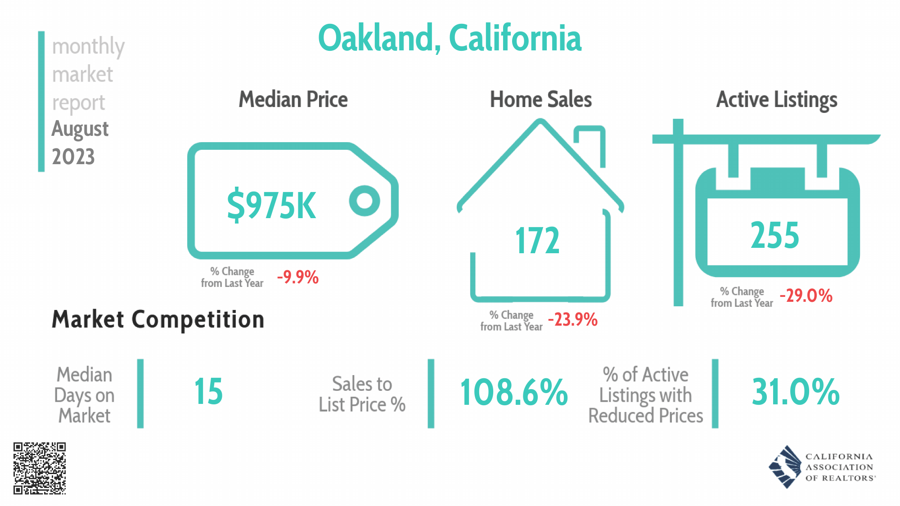

Slide 14
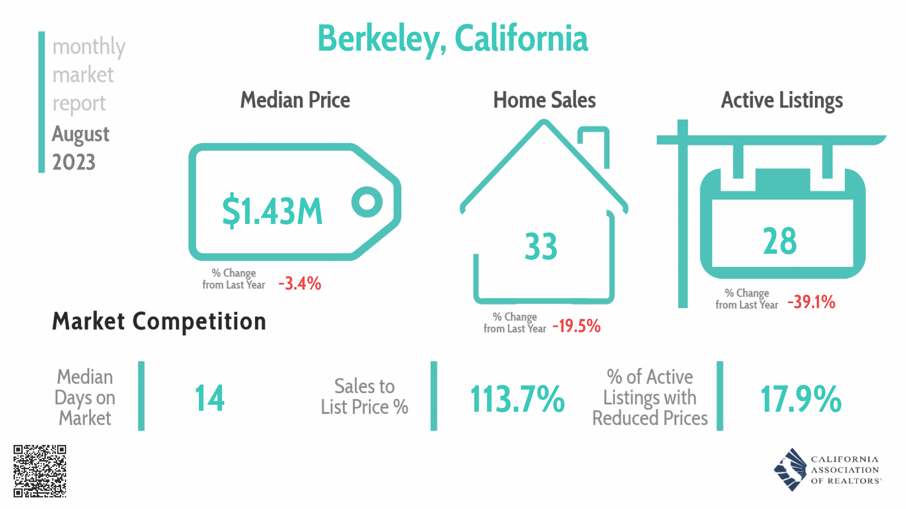

Slide 15
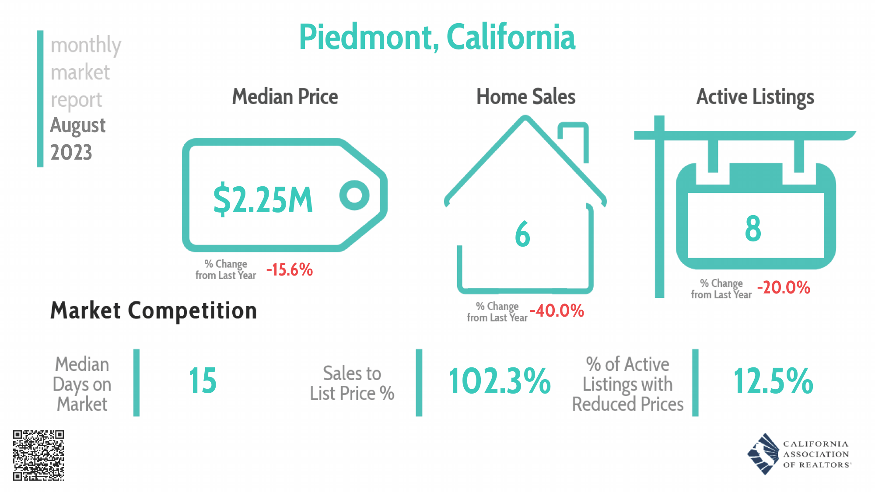

Slide 16
Don’t take your foot off the gas

Slide 17
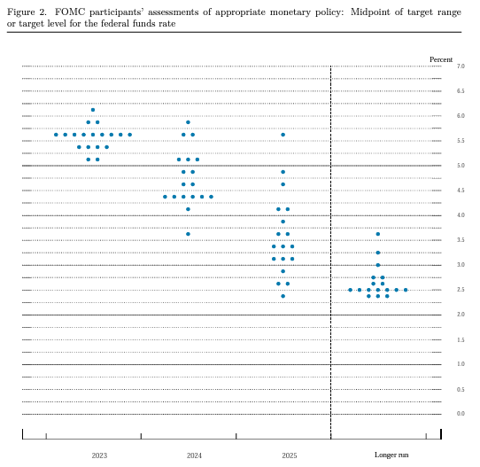
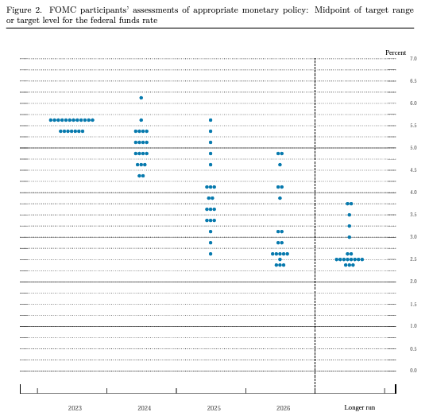
June 2023
September 2023

Slide 18
Last mile on inflation is toughest, rates down slowly
Notes:
Headline index increased 4.9% for the 12 months ending April, which was the smallest 12-month increase since the period ending April 2021.
Grocery store prices fell 0.2% in April and have now posted the first back-to-back monthly declines since the summer of 2019.

Slide 19
Bond market finally baking in “higher for longer”

Slide 20
Mortgage rates likely to remain elevated this year
SERIES: Fed Funds Rate, Fed’s Dot Plot
SOURCE: Federal Reserve, the Wall Street Journal

Slide 21
Affordability and purchasing power near all-time lows

Slide 22
Buyer demand reflects impact of higher rates

Slide 23
Remote work exacerbating structural issues

Slide 24
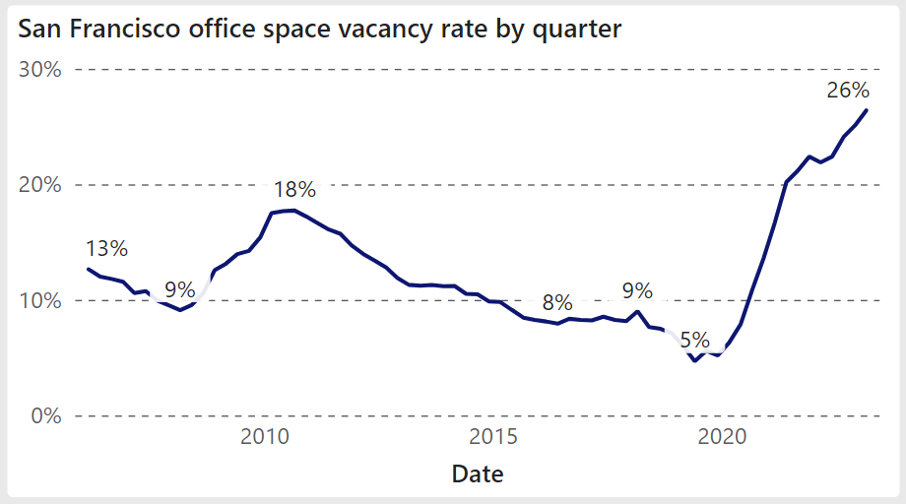

Slide 25
Which brings us to today…

Slide 26
Yield curve remains inverted due to short-run worries

Slide 27
Inventory remains the biggest challenge
Notes:
-needs header

Slide 29
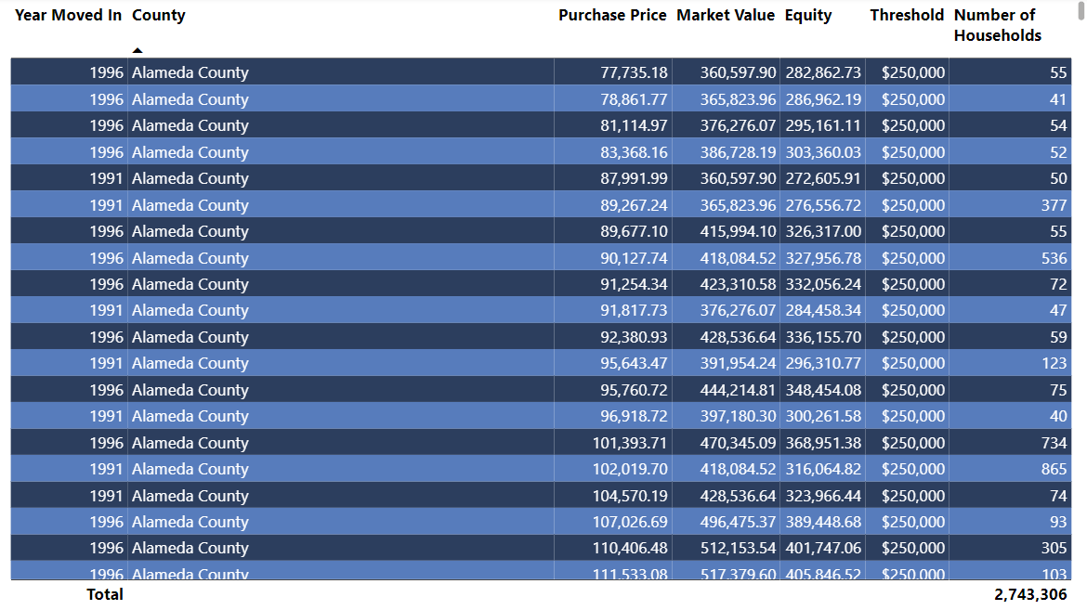

Slide 30
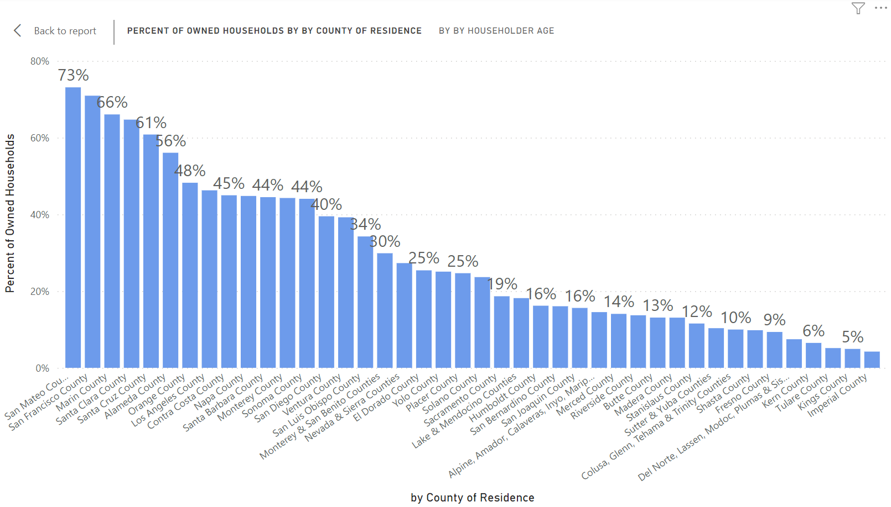

Slide 31
Sellers’ housing tenure reached a record high
  Homeowners holding onto homes longer than ever:
  Low rate on current mortgage
  Low property taxes
  Capital gains hit
  Where can I afford to go?
  Remodel and stay
SERIES: 2023 Housing Market Survey
SOURCE: CALIFORNIA ASSOCIATION OF REALTORS®

Slide 33
Insurance has become a big issue for home buying
Q. Did the buyer have difficulties obtaining fire/homeowners insurance?
SERIES: 2023 Housing Market Survey
SOURCE: CALIFORNIA ASSOCIATION OF REALTORS®

Slide 34
So where is the opportunity?
Spoiler alert: it lies with the consumer!

Slide 35
There’s an educational opportunity
Brother-in-law effect
Financial education
Value of homeownership
Golden rule of timing
Benefits of housing supply
Consequence of no supply

Slide 36







Buyers and sellers need us more than ever
August 2023
Median
Sales Price
$859,800
+3.0% Y2Y
Unsold Inventory Index
2.4 months
-14.3% Y2Y
Median
Days on Market
18 days
-21.7% Y2Y
Sales Above List
47%
+15pp Y2Y
Reduced Listings
34%
-9pp Y2Y
30-Yr FRM
Rate
7.07%
+185bps Y2Y

Slide 37


Being a buyer’s agent is tough, but worth the effort
1
SERIES: 2023 Housing Market Survey
SOURCE: CALIFORNIA ASSOCIATION OF REALTORS®
Notes:
Share of first-time buyers increased for the wrong reason, due partly to lack of repeat buyers in the market.

Slide 38

Share of vacation home buying continued to climb
SERIES: 2023 Housing Market Survey
SOURCE: CALIFORNIA ASSOCIATION OF REALTORS®
Notes:
38
Vacation home share continued to climb.

Slide 39
Investor share dips as rent growth slows
Notes:
39
More investors purchased their properties to flip.

Slide 40


All cash buyers still in the market are rates rise
Over a quarter of buyers paid with all cash
Higher interest rates and tight supply push up the share of all cash buyers
SERIES: 2023 Housing Market Survey
SOURCE: CALIFORNIA ASSOCIATION OF REALTORS®

Slide 41


Share of international buyers rebounding in CA
SERIES: 2023 Housing Market Survey
SOURCE: CALIFORNIA ASSOCIATION OF REALTORS®

Slide 42
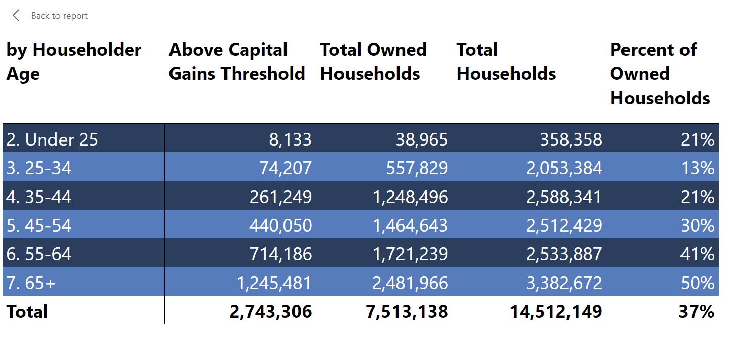

Slide 43
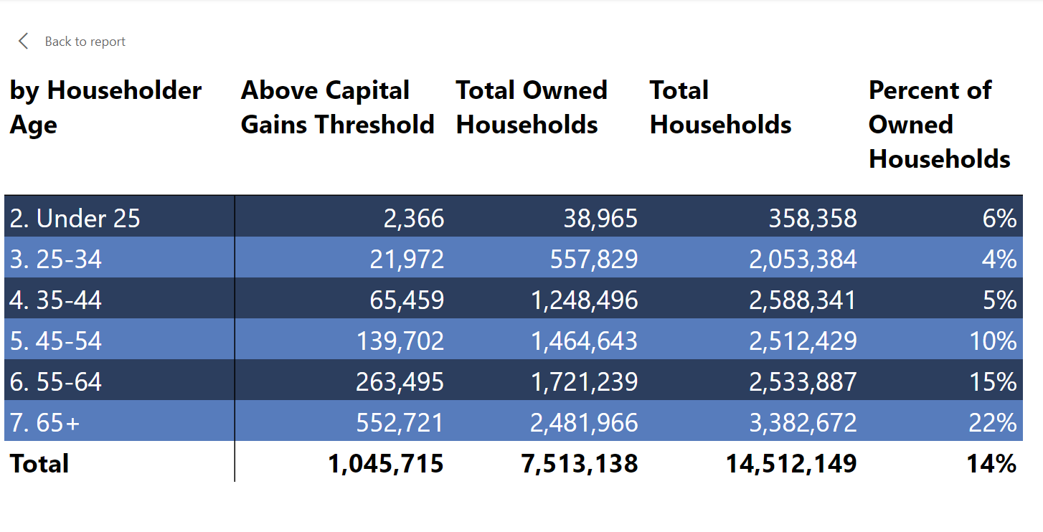

Slide 44
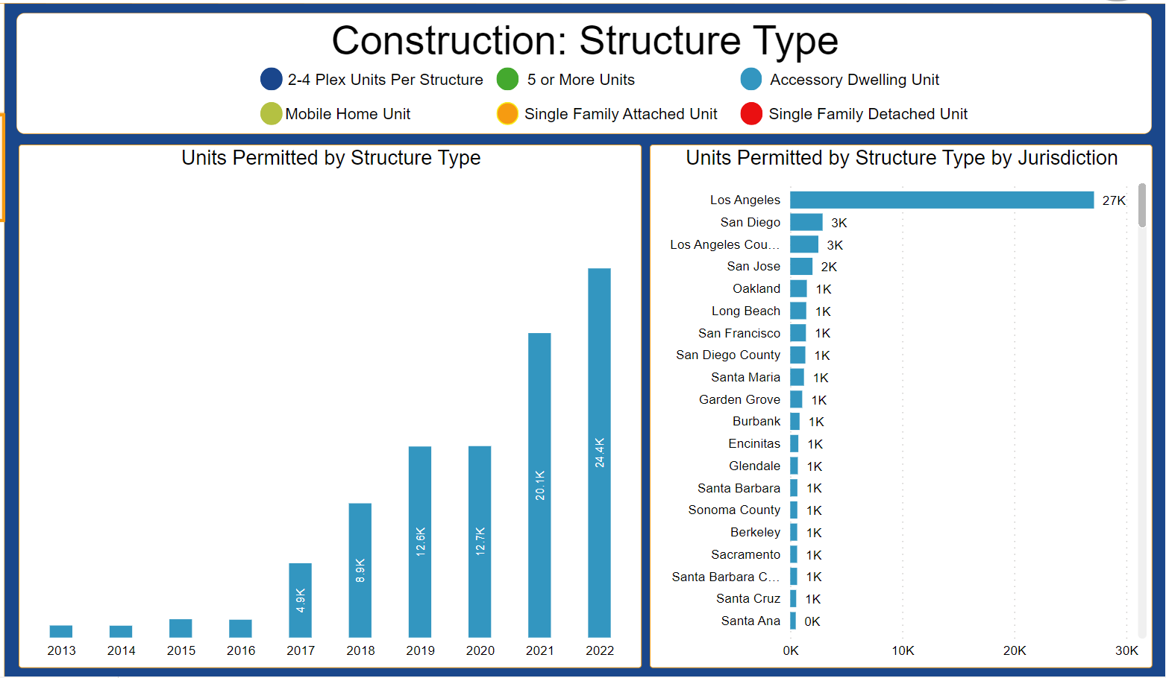

Slide 45
Taking all that into account…

Slide 46
U.S. economic outlook
 | 2016 | 2017 | 2018 | 2019 | 2020 | 2021 | 2022 | 2023p | 2024f
US GDP | 1.6% | 2.3% | 3.0% | 2.2% | -3.5% | 5.9% | 2.1% | 1.7% | 0.7%
Nonfarm Job Growth | 1.8% | 1.6% | 1.6% | 1.3% | -5.7% | 2.8% | 4.3% | 1.7% | 0.2%
Unemployment | 4.9% | 4.4% | 3.9% | 3.7% | 8.1% | 5.4% | 3.6% | 3.7% | 4.4%
CPI | 1.4% | 2.1% | 2.4% | 1.8% | 1.2% | 4.7% | 8.0% | 3.9% | 2.6%
Real Disposable Income, % Change | 2.7% | 2.9% | 4.0% | 2.9% | 5.8% | 1.9% | -6.1% | 3.5% | 2.1%

Slide 47
California economic outlook
 | 2016 | 2017 | 2018 | 2019 | 2020 | 2021 | 2022 | 2023p | 2024f
Nonfarm Job Growth | 2.3% | 2.1% | 2.1% | 1.5% | -6.9% | 3.2% | 5.0% | 1.4% | 0.5%
Unemployment | 5.5% | 4.8% | 4.3% | 4.1% | 10.3% | 7.4% | 4.4% | 4.6% | 5.0%
CA Population (Million) | 39.4 | 39.5 | 39.6 | 39.6 | 39.5 | 39.5 | 39.5 | 39.5 | 39.5
Population Growth | 0.6% | 0.4% | 0.2% | 0.1% | -0.9% | -0.5% | -0.4% | 0.0% | 0.0%

Slide 48
California housing market outlook
 | 2016 | 2017 | 2018 | 2019 | 2020 | 2021 | 2022 | 2023p | 2024f
SFH Resales (000s) | 417.7 | 424.9 | 402.6 | 398.0 | 411.9 | 444.5 | 342.0 | 266.2 | 327.1
% Change | 2.0% | 1.7% | -5.2% | -1.2% | 3.5% | 7.9% | -23.1% | -22.2% | 22.9%
Median Price ($000s) | $502.3 | $537.9 | $569.5 | $592.4 | $659.4 | $786.8 | $822.3 | $810.0 | $860.3
% Change | 5.4% | 7.1% | 5.9% | 4.0% | 11.3% | 19.3% | 4.5% | -1.5% | 6.2%
Housing Affordability Index | 31% | 29% | 28% | 31% | 32% | 26% | 19% | 17% | 17%
30-Yr FRM | 3.6% | 4.0% | 4.5% | 3.9% | 3.1% | 3.0% | 5.3% | 6.7% | 6.0%

Slide 49
Thank you!!

