Slide 1
2023 California
Economic & Housing
Market Forecast
Bridge Association of REALTORS®
October 26, 2022
Jordan G. Levine
Vice President & Chief Economist
California Association of REALTORS®

Slide 2
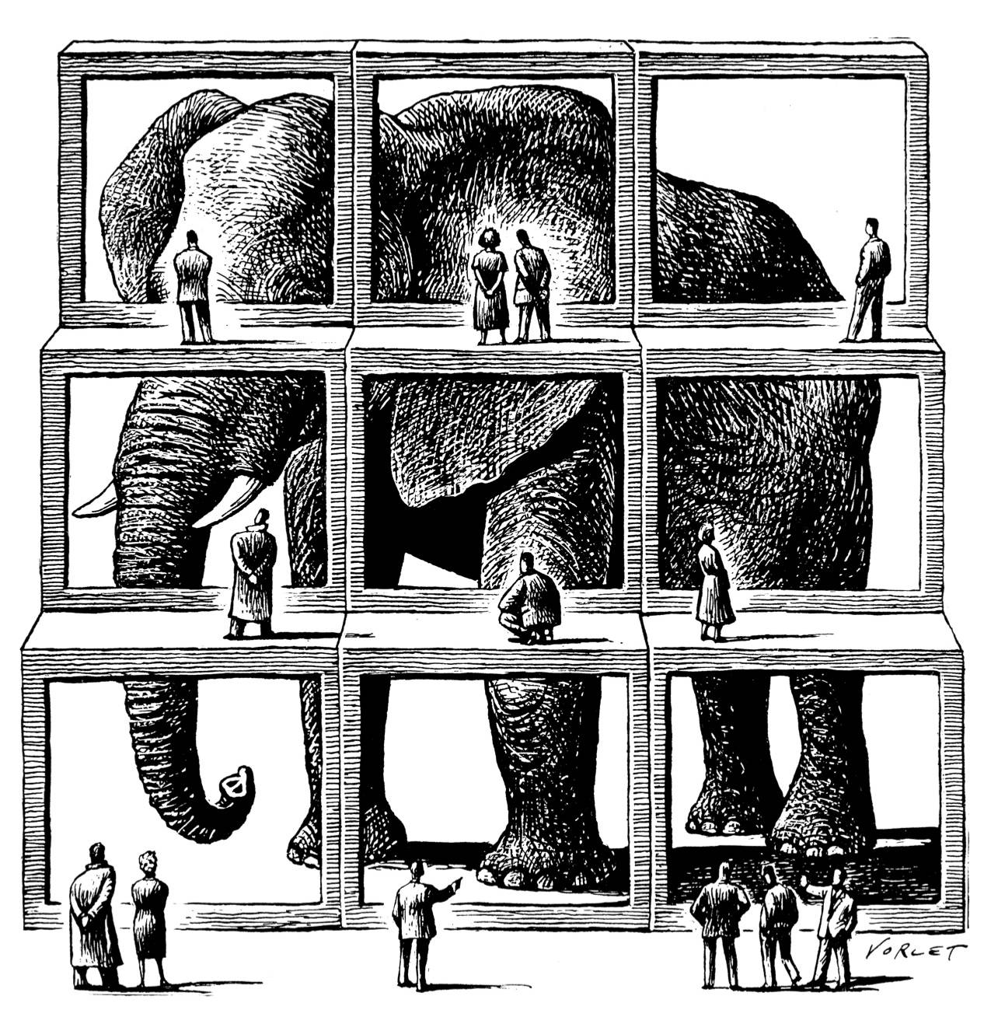

Slide 3
Context Matters
  It’s not 2008
  all over again
  Market shifts are good for buyers
  Cost of waiting
  could be high

Slide 4
Biggest hit over shortest timeframe in California
-2.8 million jobs lost in 2 months time

Slide 5

Most high-wage industries insulated from COVID

Slide 6
2/3 of buyers still work remotely at least part time
Do you currently work remotely?
(n=1,118)
Notes:
6

Slide 7
Plays a big role in buyer’s decisions to move/buy
Did your ability to work remotely influence your decision on your current residence?
(n=710)
SERIES: 2022 Consumer Survey
SOURCE: CALIFORNIA ASSOCIATION OF REALTORS®
Notes:
7

Slide 8
Interest rates fell to the lowest level in over 50 years

Slide 9
More buying power for buyers (given to sellers…)
Interest Rate Effect on Purchasing Power | 24%
Cumulative Price Growth, 2019-2022 | 46%

Slide 10
Mortgage applications at highest level in a decade

Slide 11
First-time buyers rose to highest level in a decade

Slide 12

Not just primary residences, a lot of second homes
Notes:
12
Demand for vacation homes or second homes remain elevated in 2021, as work-from home policies solidified while mortgage rates continue to stay low by historical standards. The share of vacation/second home sales continues to rise in 2021 and surges to the highest level in nine years. Despite an improvement in the pandemic situation, more employers began to adopt permanent remote working policies that allow employees to work further away from the office. Many workers who have this flexibility chose to live in resort communities in search of more space and a healthier lifestyle.

Slide 13
California sales shot up—rising to 12-year high

Slide 14
Tope end of the market shot through the roof too!
SERIES: Percent Change in Sales
SOURCE: CALIFORNIA ASSOCIATION OF REALTORS®

Slide 15
Bay Area is a microcosm of the state

Slide 16
Similar story for the region by segment

Slide 17
Unsold inventory fell to all-time low of 1.2 months
Notes:
Note: “Unsold Inventory Index” represents the number of months it would take to sell the remaining inventory for the month in question. The remaining inventory for the month is defined as the number of properties that were “Active”, “Pending”, and “Contingent” (when available) and divide the sum by the number of “Sold” properties for the month in question.

Slide 18
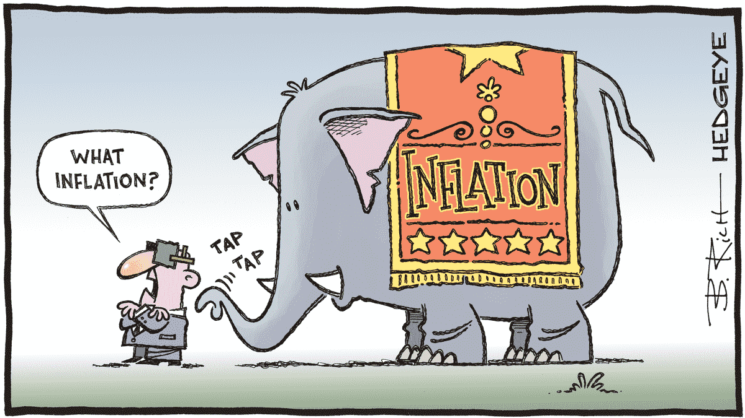
Consequences of the supply/demand imbalance

Slide 19
Homes were selling more quickly than ever before

Slide 20
Vast majority of homes selling over asking price

Slide 21
Bay Area was even more competitive

Slide 22
hi demand + no supply + low rates = higher prices

Slide 23
Even the cheaper areas are expensive now

Slide 24
We also pumped a ton of money into the system

Slide 25
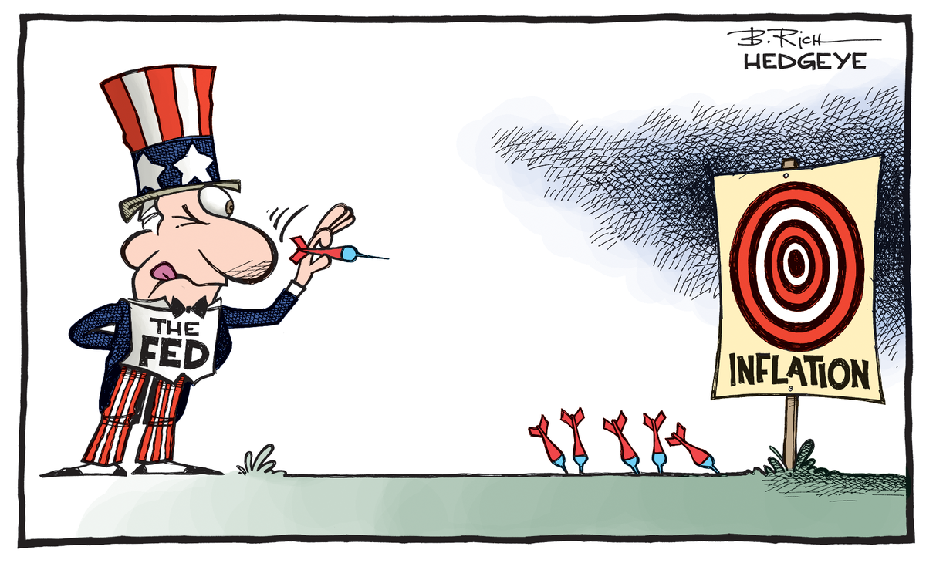

Slide 26
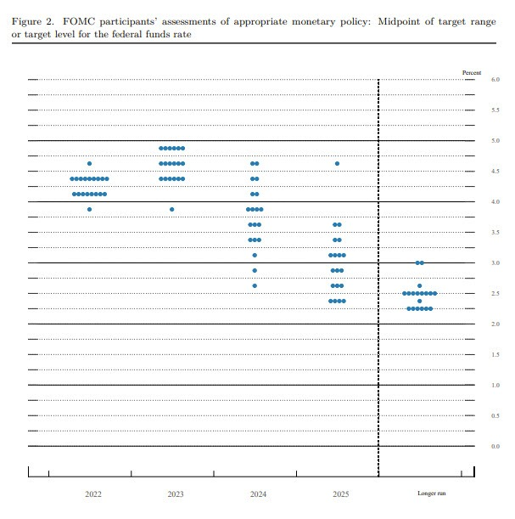
Fed not taking their foot off the gas any time soon
4.6% Fed Funds Rate – Up From 3.8% in June 2022

Slide 27
Fed’s war on inflation hurts purchasing power
SERIES: Fed Funds Rate, Fed’s Dot Plot
SOURCE: Federal Reserve, the Wall Street Journal

Slide 28
Effect of rising rates on mortgage payments

Slide 29
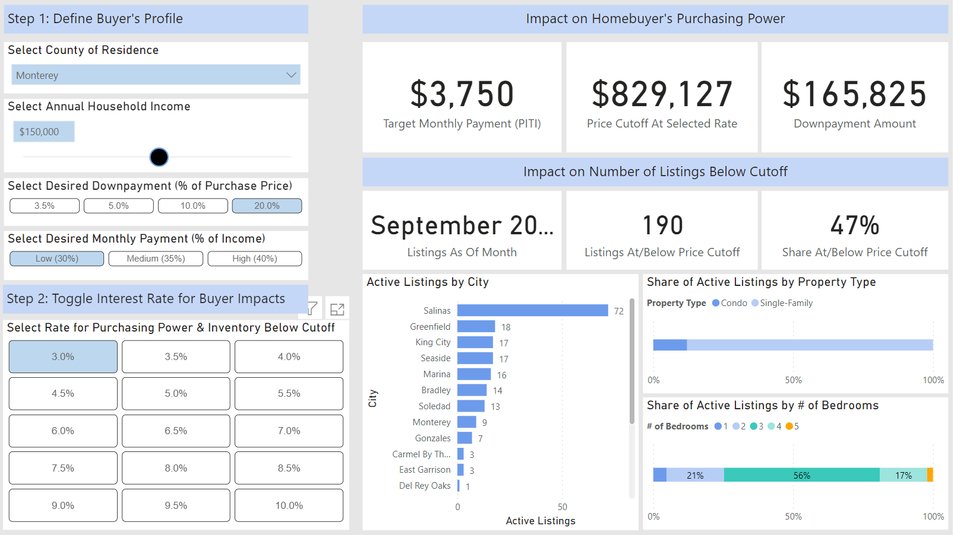

Slide 30
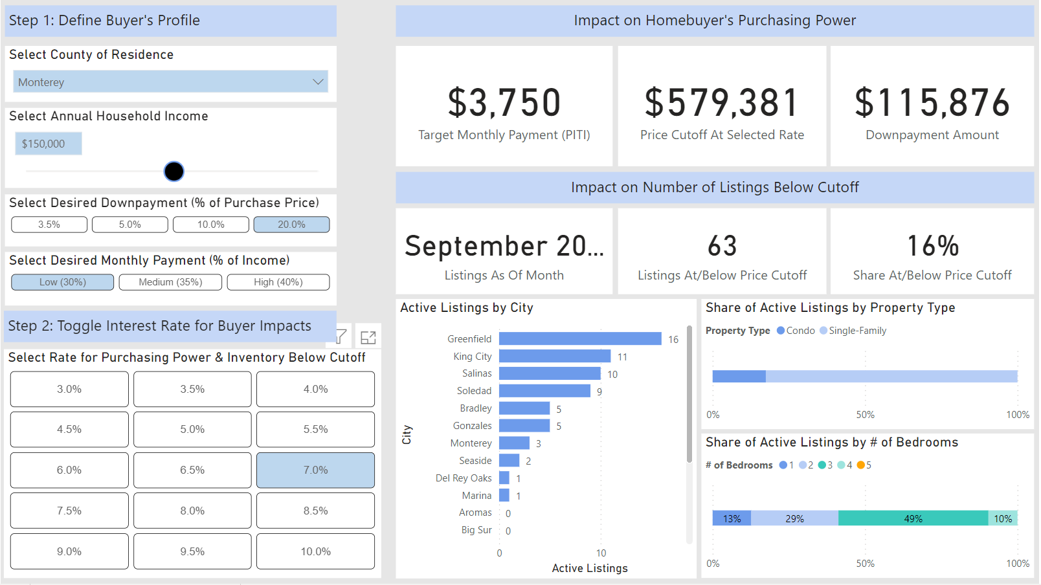

Slide 31
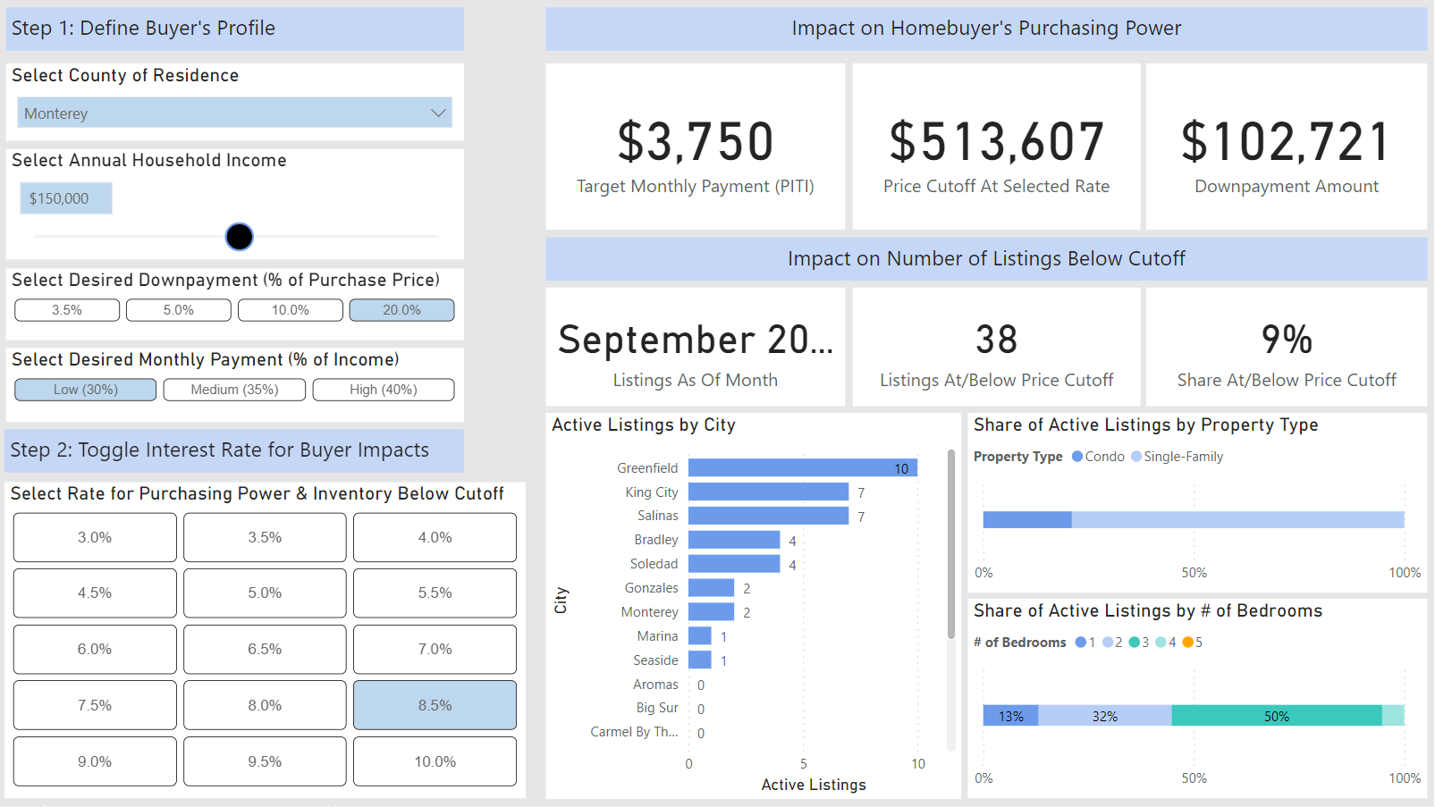

Slide 32
Slower prices canceled out by higher rates

Slide 33

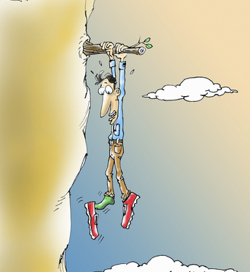

Slide 34
A big chunk of this is econ 101 stuff…

Slide 35
The Bay Area is also a good example of this

Slide 37
Likely rising higher unless deeper recession arrives
SERIES: Fed Funds Rate, Fed’s Dot Plot
SOURCE: Federal Reserve, the Wall Street Journal

Slide 38
First-time buyers struggling to make numbers pencil
SERIES: 2021 Housing Market Survey
SOURCE: CALIFORNIA ASSOCIATION OF REALTORS®

Slide 39
Demand slips, but not too scary beside 2016-2019

Slide 40
Sales hovering in the 300,000 range for now
SERIES: Sales of Existing Single Family Homes
SOURCE: CALIFORNIA ASSOCIATION OF REALTORS®
Notes:
*Sales are seasonally adjusted and annualized

Slide 41


Investors are back to rentals as moratoriums expire
Rent
Flip
Vs.
2014: 30%
2015: 26%
2016: 20%
2017: 24%
2018: 26%
2019: 18%
2020: 27%
2021: 29%
2022: 18%
2014: 70%
2015: 74%
2016: 80%
2017: 76%
2018: 74%
2019: 82%
2020: 73%
2021: 71%
2022: 82%
SERIES: 2022 Housing Market Survey
SOURCE: CALIFORNIA ASSOCIATION OF REALTORS®
Notes:
41

Slide 42


Slide 43
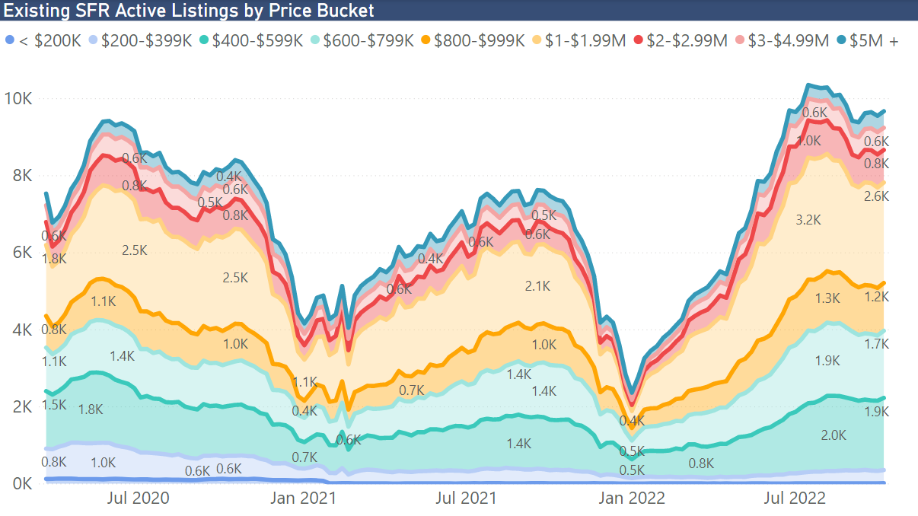

Slide 44
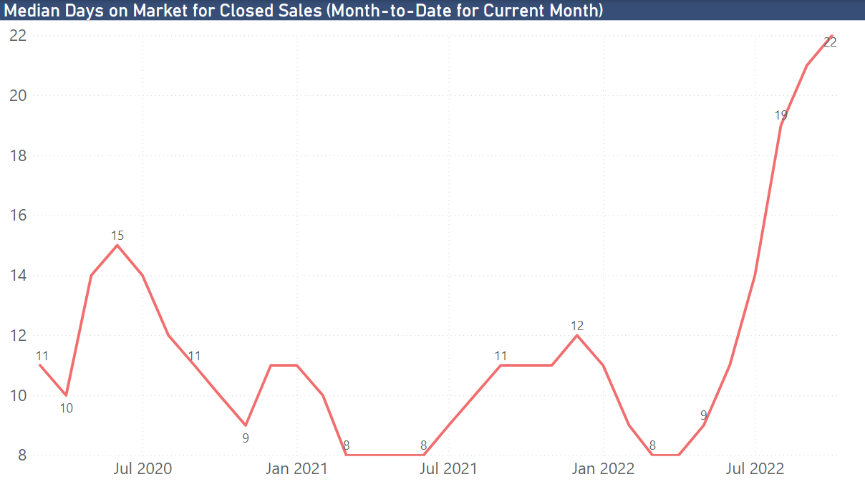

Slide 45
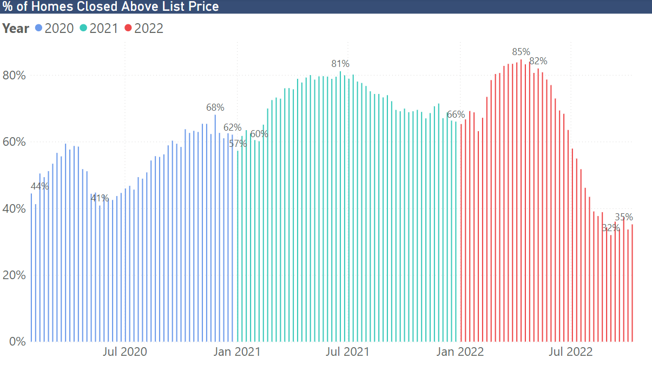

Slide 46
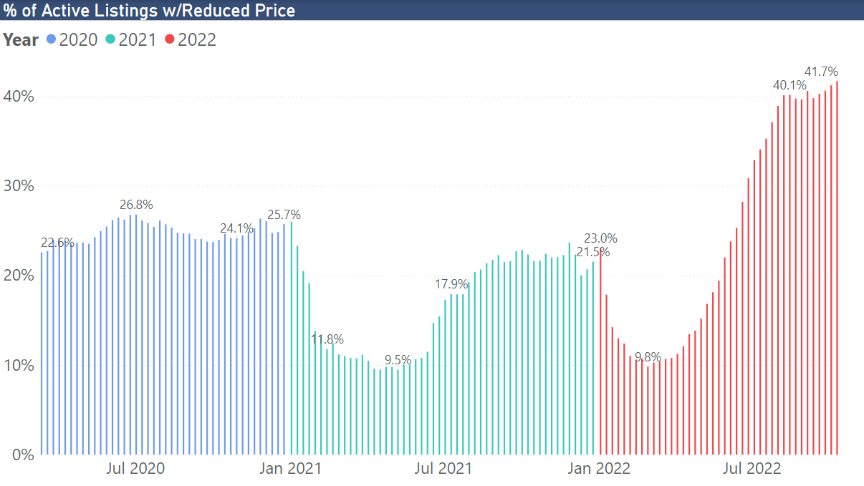

Slide 47


Slide 48
California doing better on delinquency than the rest

Slide 49
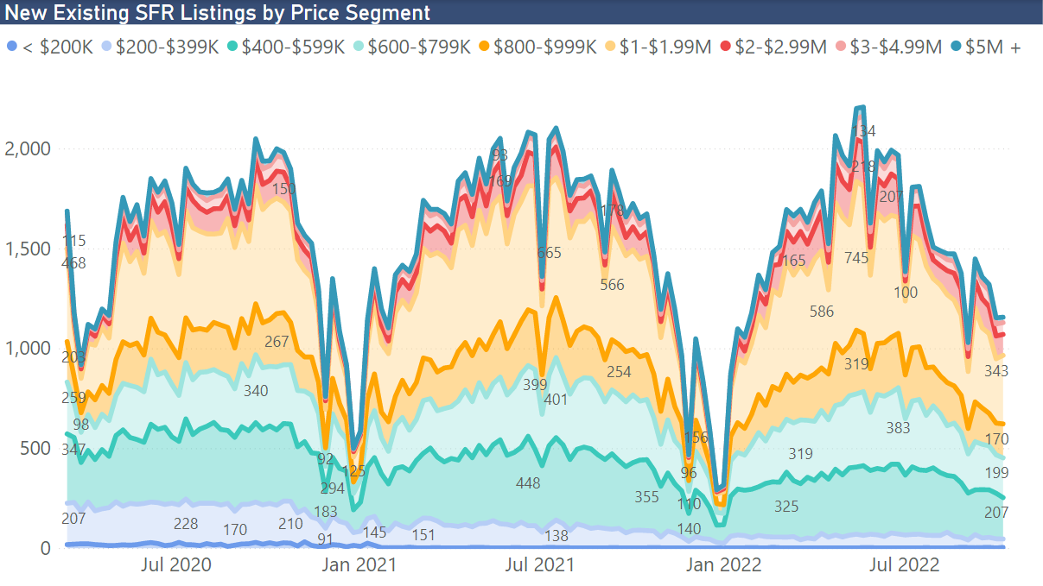

Slide 50
Rates still low by historical standards, and set to rise
SERIES: Fed Funds Rate, Fed’s Dot Plot
SOURCE: Federal Reserve, the Wall Street Journal

Slide 51
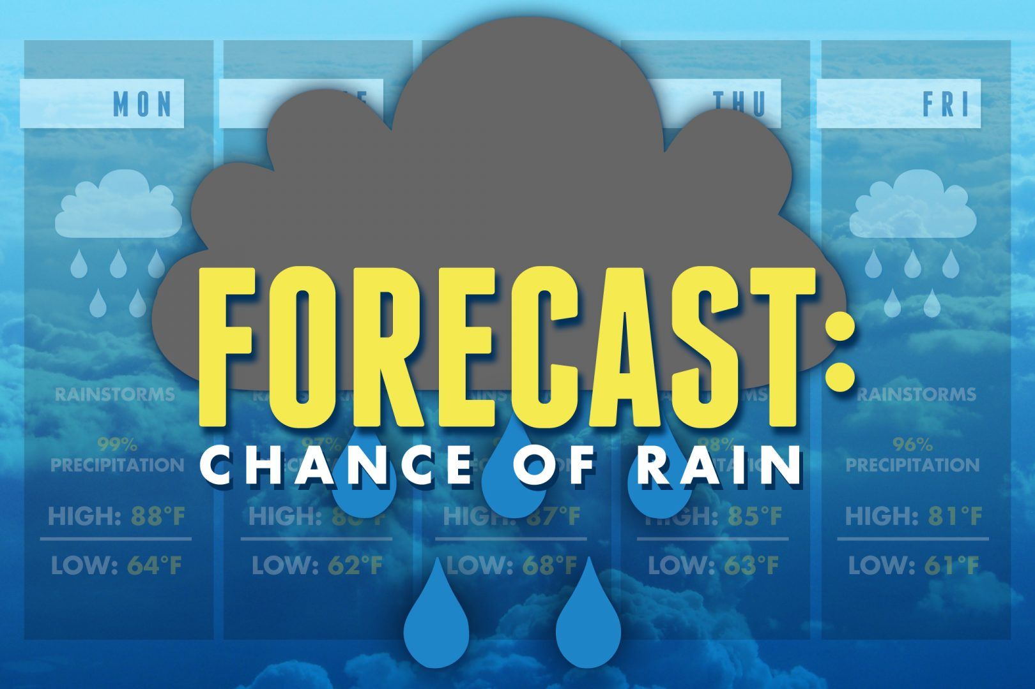

Slide 52
U.S. economic outlook
 | 2016 | 2017 | 2018 | 2019 | 2020 | 2021 | 2022p | 2023f
US GDP | 1.6% | 2.3% | 3.0% | 2.2% | -3.5% | 5.7% | 0.9% | -0.5%
Nonfarm Job Growth | 1.8% | 1.6% | 1.6% | 1.3% | -5.7% | 2.8% | 3.4% | -0.5%
Unemployment | 4.9% | 4.4% | 3.9% | 3.7% | 8.1% | 5.4% | 3.7% | 4.4%
CPI | 1.4% | 2.1% | 2.4% | 1.8% | 1.2% | 4.7% | 8.0% | 4.4%
Real Disposable Income, % Change | 2.7% | 2.9% | 4.0% | 2.9% | 5.8% | 2.2% | -5.4% | 0.2%

Slide 53
California housing market outlook
 | 2015 | 2016 | 2017 | 2018 | 2019 | 2020 | 2021 | 2022p | 2023f
SFH Resales (000s) | 409.4 | 417.7 | 424.9 | 402.6 | 398.0 | 411.9 | 444.5 | 359.2 | 333.4
% Change | 7.0% | 2.0% | 1.7% | -5.2% | -1.2% | 3.5% | 7.9% | -19.2% | -7.2%
Median Price ($000s) | $476.3 | $502.3 | $537.9 | $569.5 | $592.4 | $659.4 | $786.7 | $831.5 | $758.6
% Change | 6.6% | 5.4% | 7.1% | 5.9% | 4.0% | 11.3% | 19.3% | 5.7% | -8.8%
Housing Affordability Index | 31% | 31% | 29% | 28% | 31% | 32% | 26% | 19% | 18%
30-Yr FRM | 3.9% | 3.6% | 4.0% | 4.5% | 3.9% | 3.1% | 3.0% | 5.2% | 6.6%

Slide 56
Thank You
This presentation can be found on
www.car.org/marketdata
Speeches & Presentations
jordanl@car.org

